Slide 1
Final Cut Pro
Transbaikal State University Power Engineering Faculty
The Department of Computer Science, Technique and Applied Math
Is done by Purtov Georgy, student of group CMC-21

Slide 2
Introduction
Final Cut Pro (formerly Final Cut Pro X) is a professional video editor for macOS. It was developed by Macromedia, then by Apple. The program allows users to transfer videos from external drives to a computer for processing.

Slide 3
Today we are going to look at the following points
Describing video editor
Discussing advantages and disadvantages
Describing main functions and possibilities
Enlarging the knowledge of watchers
Displaying of my video projects
Demonstrating of creation process

Slide 4
Perfected for the new MacBook
Complex tasks, like video analysis for object tracking or automatic cropping, are lightning fast on the Apple Neural Engine. Creators can now do advanced editing, color grading, and delivery in HDR on 8K ProRes video — even when they’re miles away from the edit bay.

Slide 5
Optimized for Apple silicon.
Final Cut Pro features breathtaking performance and efficiency on Mac computers with Apple silicon. Tap into superfast unified memory shared across the CPU, the GPU, and the Apple Neural Engine to play back more high-resolution video streams and render your movie in record time.

Slide 6
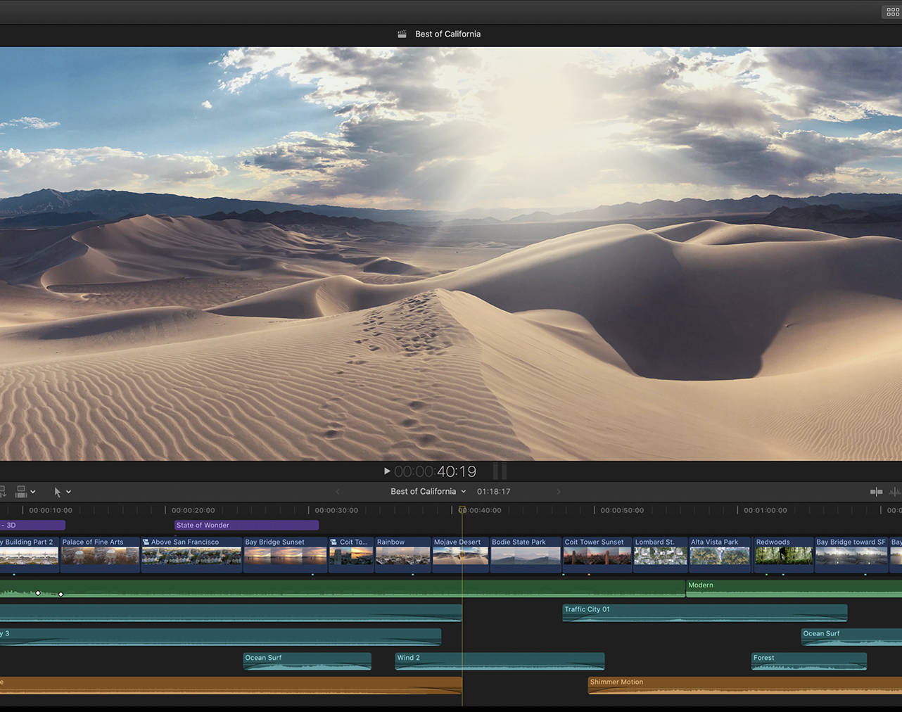
Video Editing
The Magnetic Timeline allows you to easily experiment with story ideas by moving and trimming clips without collisions or sync problems. Use Compound Clips to bundle separate video and audio clips into a single movable package, Color coding makes it easy to identify different types of content, with the ability to customize the look of your timeline while you edit.

Slide 7
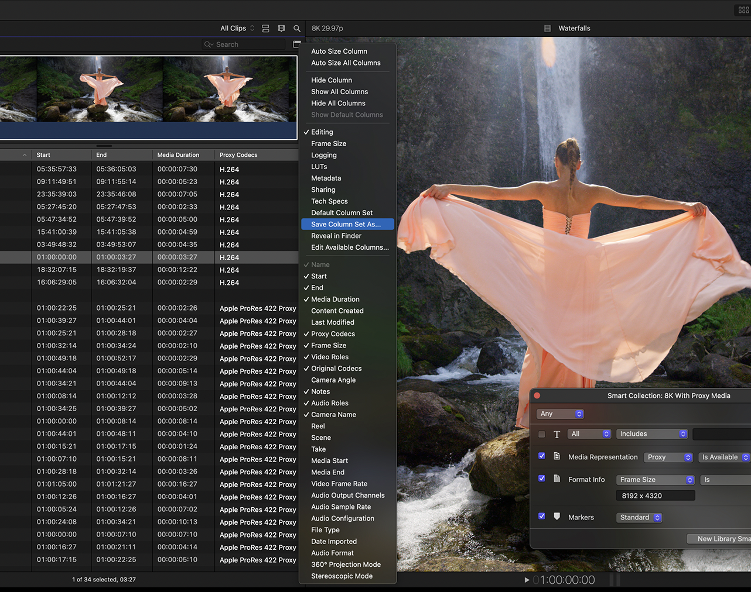
Organizing Tools
Final Cut Pro offers the most advanced organizing tools of any professional video editing application. Easily tag entire clips or clip ranges with metadata for searching, and create Smart Collections that automatically collect content according to a set of custom criteria.

Slide 8
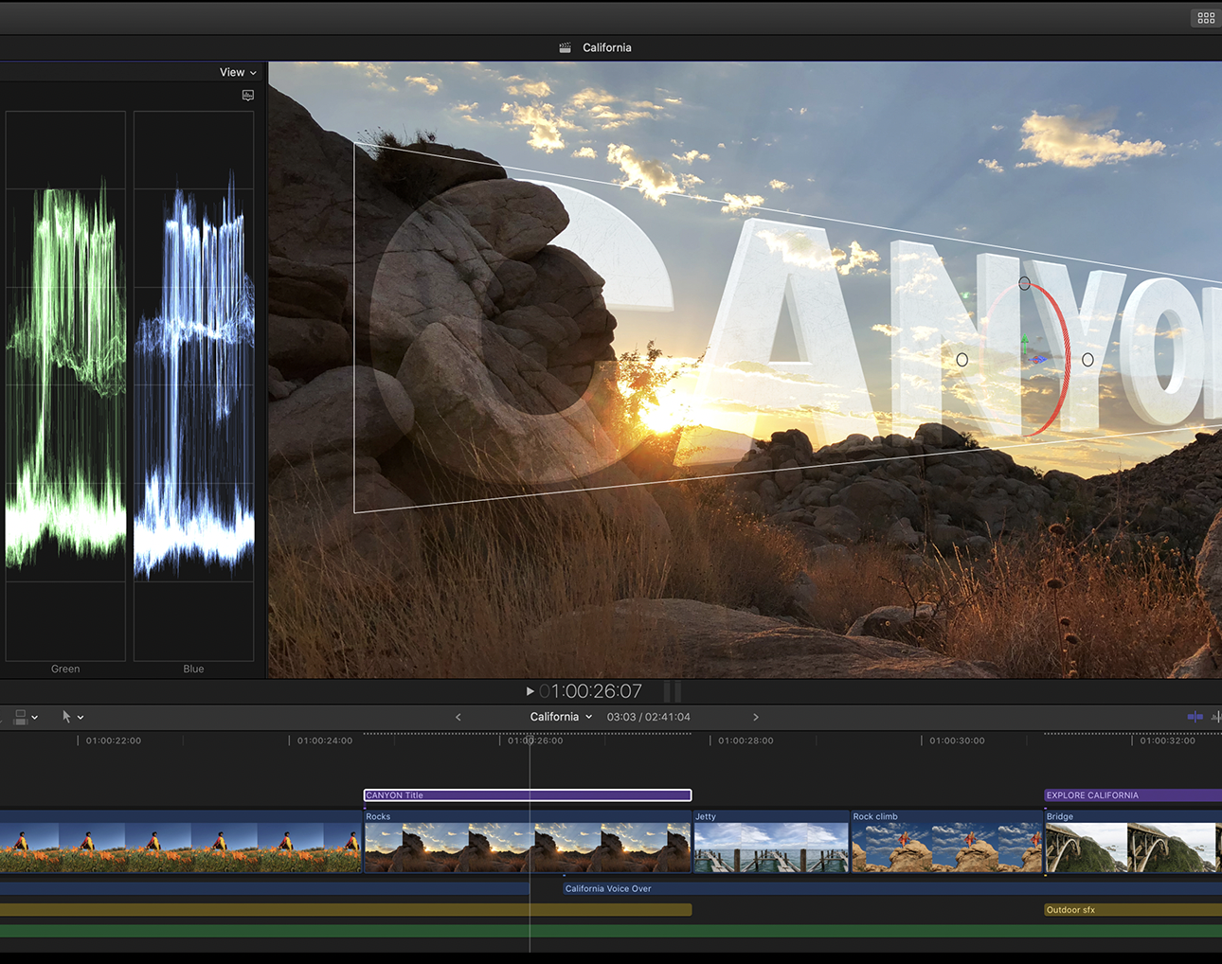
Motion Graphics
Create 2D and 3D titles right in Final Cut Pro, apply and modify filters, and use the built-in chroma key for high-quality green- and blue-screen effects.

Slide 9
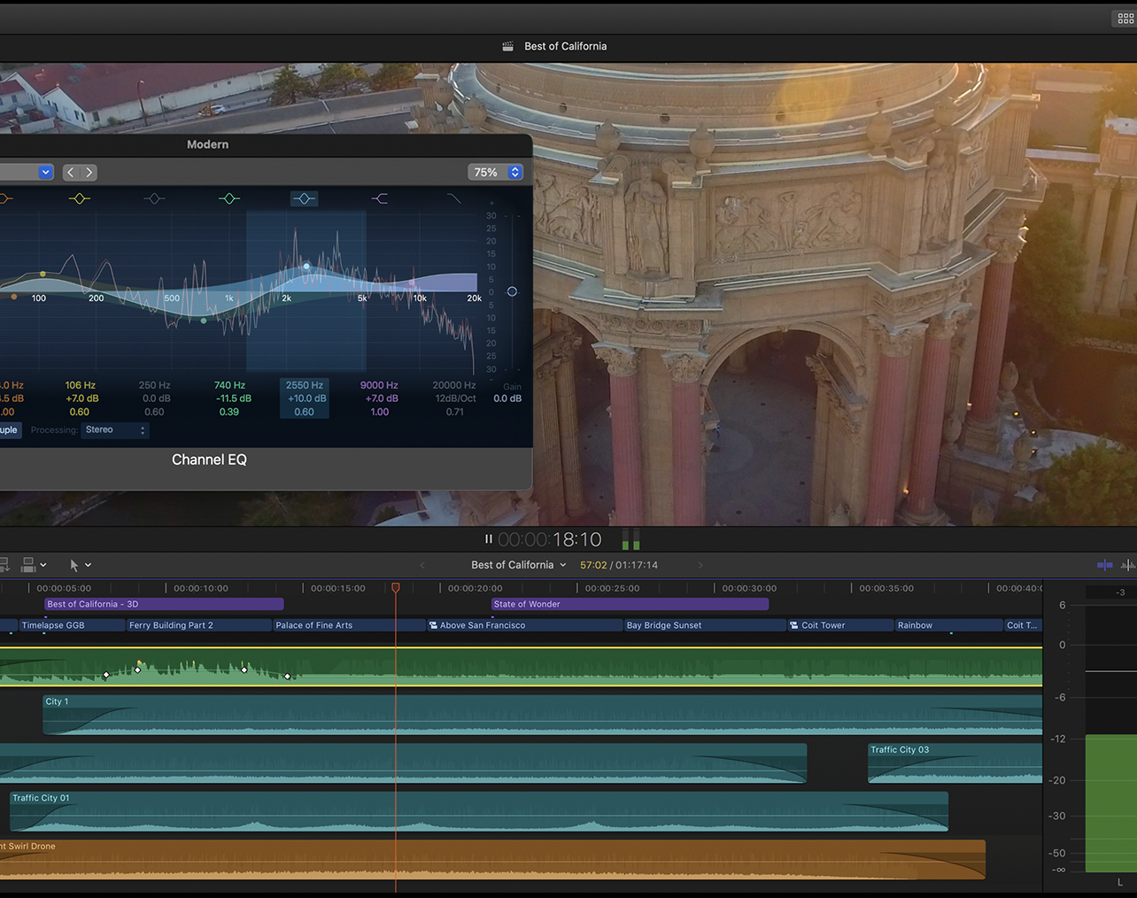
Audio
Final Cut Pro lets you edit multichannel audio using built-in tools for removing background noise and optimizing levels. Adjust multichannel audio files in the timeline or open the inspector for more information and options.

Slide 10
Advanced color grading. Every pixel closer to perfection.
Professional color grading tools are built into Final Cut Pro, including a dedicated color inspector with color wheels, color curves, and hue/saturation curves. All color grading tools and scopes support High Dynamic Range (HDR) video.

Slide 11
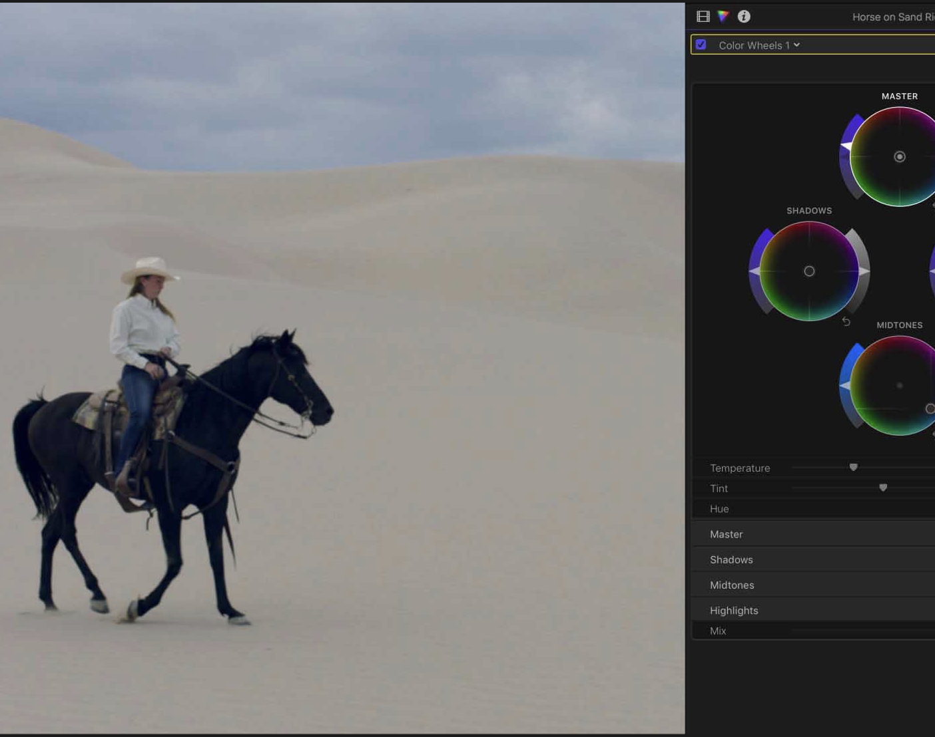
Color Wheels
Unique color wheels improve on traditional controls by combining hue, saturation, and brightness into a single, simple interface.

Slide 12
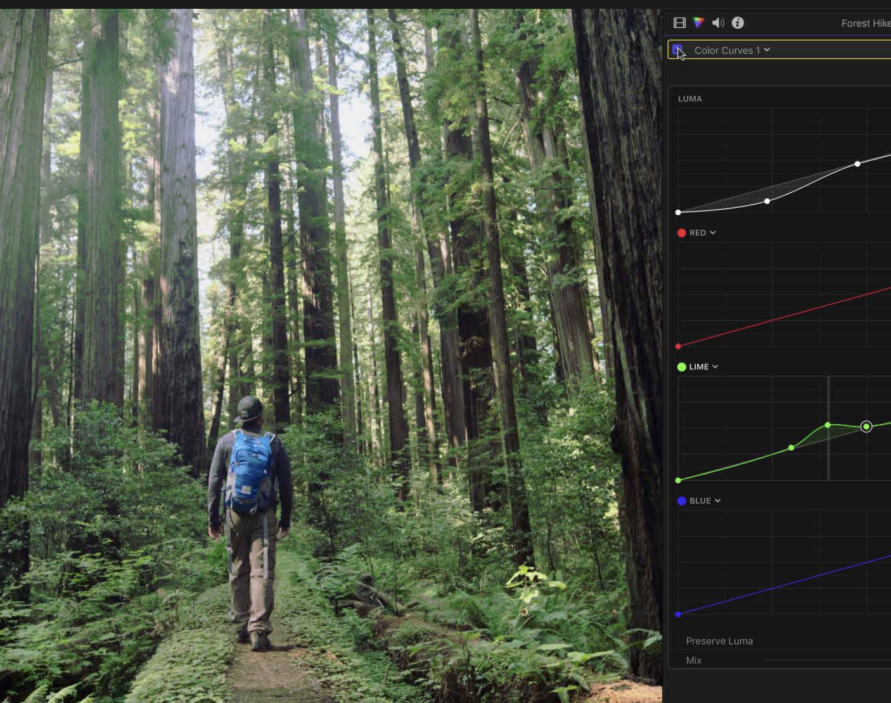
Color curves
Color and luminance curves allow ultrafine level adjustments with multiple control points to target specific color and brightness ranges.

Slide 13
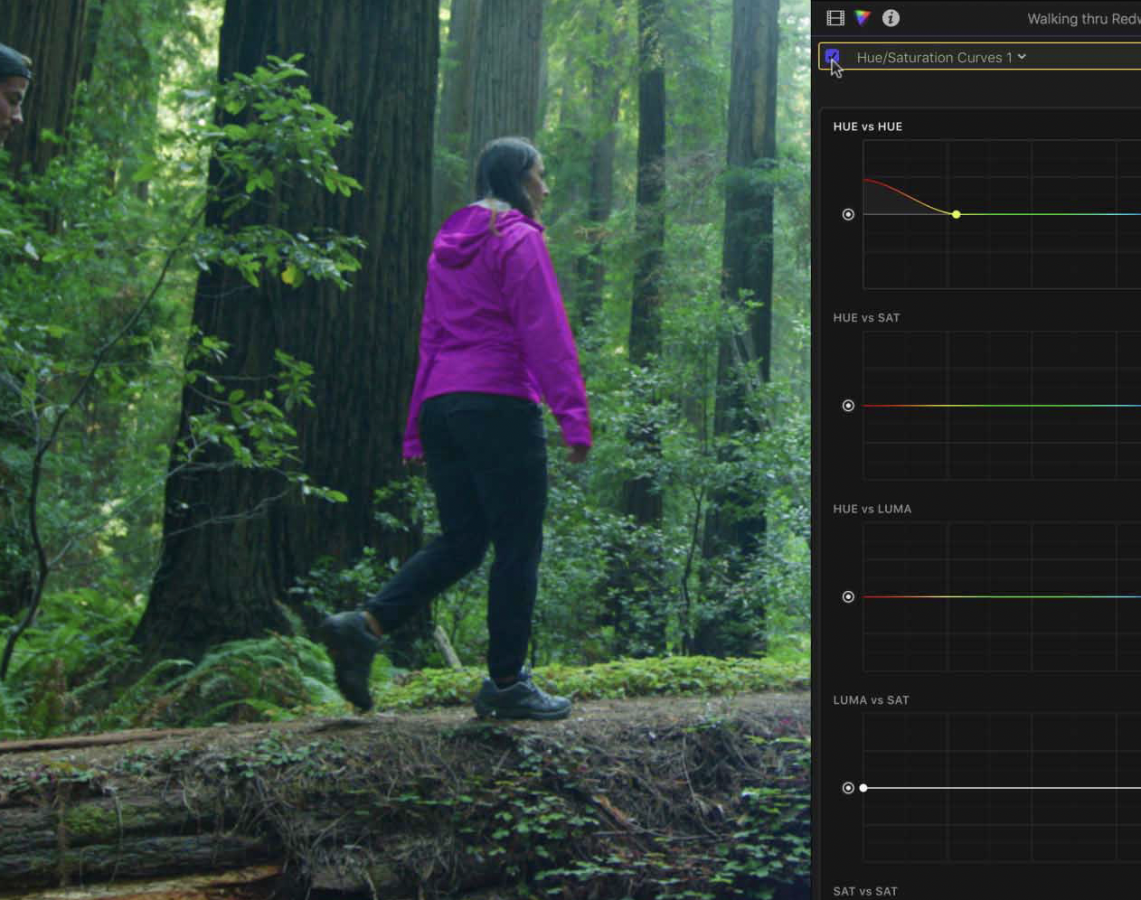
Hue/Saturation curves
Sample a color with an eyedropper and change just the hue, saturation, or luminance of a specific color within the image.

Slide 14
The flexibility of RAW with the performance of ProRes.
Import, edit, and grade original, untouched footage with RAW data straight from your camera sensor — without sacrificing any speed or smoothness. Create native ProRes RAW files using Atomos recorders and the DJI Inspire 2 drone and experience all the creative advantages of RAW with the real-time performance of ProRes.

Slide 15

Atomos NINJA V recorder

Slide 16

DJI Inspire 2 drone

Slide 17
About Apple ProRes
Apple ProRes codecs provide an unparalleled combination of multistream, real-time editing performance, impressive image quality, and reduced storage rates.
All Apple ProRes codecs support all frame sizes (including SD, HD, 2K, 4K, and 5K) at full resolution. The data rates vary based on codec type, image content, frame size, and frame rate. Apple ProRes includes the following formats.

Slide 18
ProRes performance
Remarkably smooth playback and real-time, multistream editing are part of the ProRes RAW package. The format is optimized for macOS and the latest Mac computers, allowing you to render and export faster than with other RAW formats. Since ProRes RAW files are smaller than standard formats, you can fit more footage on every card.

Slide 19
RAW flexibility
Work with untouched image data directly from your camera sensor. And new ProRes RAW tools in Final Cut Pro provide enhanced settings for ISO, color temperature, and exposure offset from supported devices for an even deeper level of control.

Slide 20
Interesting fact
Final Cut Pro X inherits the name of its predecessor (Final Cut Pro), but Final Cut Pro X is a newly written Objective-C program by Apple. In November 2020, the program was renamed again to Final Cut Pro with the release of macOS Big Sur.

Slide 21
Movies edited in Final Cut Pro
X-Men Origins: Wolverine (2009)
300 (2006)
The Simpsons Movie (2007)

Slide 22
Advantages
Color grading
HDR support
ProRes and RAW support
Optimized for Mac’s and Macbook’s
Easy to learn

Slide 23
Disadvantages
Lack of Russian language
Implicit placement of Effects and Transitions
Final Cut Pro doesn’t exist for Windows or Linux

Slide 24
Conclusion
Summing up, we can say that Final Cut Pro is a high-tech audio and video processing distribution that meets all the requirements of the modern art of video and audio editing. I want to show a project I created with this software.

Slide 25


Slide 26
LIST OF REFERENCES
https://www.apple.com/ru/final-cut-pro/
https://support.apple.com/en-us/HT202410
3. В.А. Радовель «Английский язык в программировании и информационных системах»
4. https://habr.com/ru/company/liteorder/blog/291550/
5. Final Cut Pro 10.6.5

